Slide 1
The end of work: Is technology killing capitalism?
Jaime Gomez-Ramirez
Teruel, July 2017
Curso de Verano, Universidad de Zaragoza

Slide 2
Historical preambule
Types of capitalism
Platform capitalism
Macroeconomics
Secular stagnation
Finatialization rules
The march of commodification
Coda

Slide 3
Historical preambule
Notes:
The End of Jobs: Money, Meaning and Freedom Without the 9-to-5.
We can divide western history in 3 economic periods
Agricultural
Industrial
Capital
At each economic transition diminishing returns from investing than the previous limit

Slide 4
The nation state
Wealth was in the hands of those who control land (THE TERRITORY)
The AGE of EXPLORATION
The MAP WAS THE TERRITORY
Dramatic accumulation of land

Slide 5
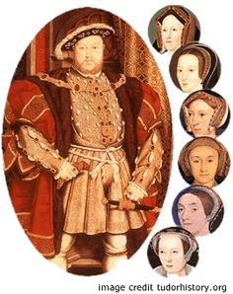
Power transfer from Church to the incipient nation state
England under Henry VIII becomes a free trade zone (remove tariffs)
Standarize weights and measures to facilitate trade (still anthropomorphic)
Dissolution of monasteries and distribution of land through sales and titles to the gentry
Private property , land more productive generating more revenues to the state rather than the church

Slide 6
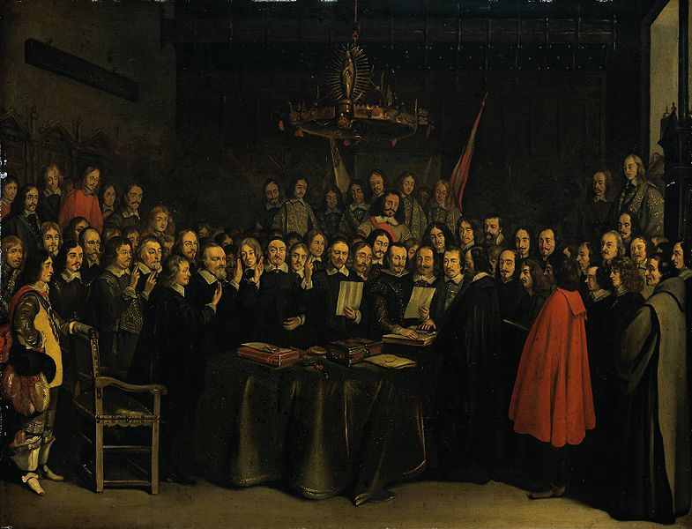
The treaty of Westphalia (1648) Put an end to the 30 years war, Habsburgs tried to impose Roman Catholicism on their Protestant subjects in Bohemia

Slide 7
Westphalian sovereignty or State sovereignty
Principle of international law that each nation-state has sovereignty over its territory and domestic affairs, to the exclusion of all external powers, on the principle of non-interference in another country's domestic affairs, and that each state (no matter how large or small) is equal in international law
The "Westphalian" doctrine of states as independent agents was bolstered by the rise in 19th century thought of nationalism, under which legitimate states were assumed to correspond to nations—groups of people united by language and culture.
Notes:
Put an end to the 30 years war, Habsburgs tried to impose Roman Catholicism on their Protestant subjects in Bohemia. It pitted Protestant against Catholic, the Holy Roman Empire against France, the German princes and princelings against the emperor and each other, and France against the Habsburgs of Spain. The prospect of a Roman Catholic reconquest of Europe vanished forever

Slide 8
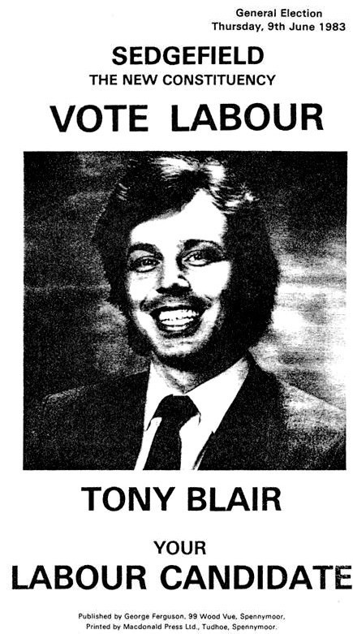
globalization had made the Westphalian approach anachronistic
Transfer of nation-state sovereign rights to supranational (European)
The notion of the state as a unitary agent can not betaken as axiomatic

Slide 9
The Social Contract
Magna carta is a contract of the barons to limit the power of the kings over the barons' plebes peasants
Later on, merchants who had no political power first and then the proletariat after the enclosure laws began to organize.
At last, the state emerges as a mechanism to avoid conflict among the incumbent, reduce class tension

Slide 10
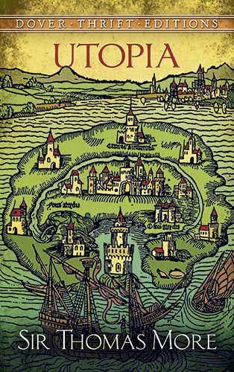
Notes:
In More’s Utopia everything is ideal. There is no ownership: everyone lives in identical houses, but the houses are exchanged every ten years to dispel any notion that individuals own their homes

Slide 11
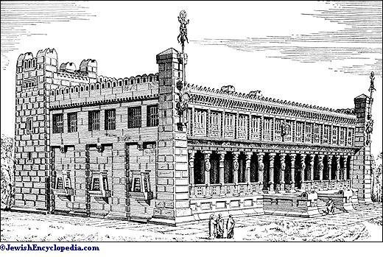
Francis Bacon New Atlantis
Salomon’s House resembles in many ways a modern research institution
Notes:
Central to the culture of Bensalem is Salomon’s House, an institution devoted to science and the acquisition of new knowledge

Slide 12
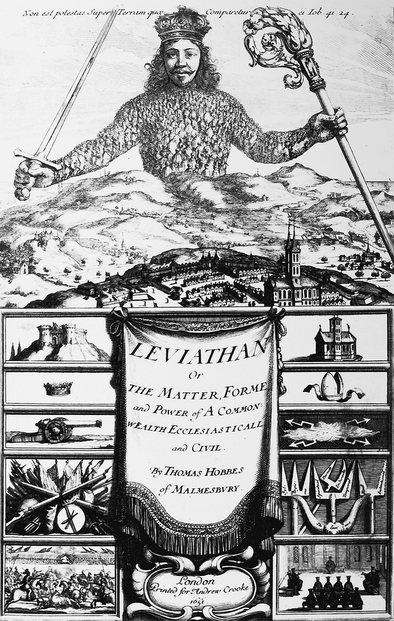

Slide 13
Thomas Hobbes the first to seek for a Physics of Society
Hobbes was not the first to imagine a utopia based on scientific reasoning
Hobbes’s Leviathan does not describe a society ready-made and shaped by the author preferences like Bacon and More do.
He rather builds it up from his mechanistic view of how humans behave.
Deductive logic: Given these postulates, what follows? If men behave this way, what kind of society can arise and be maintained?
Notes:
Hobbes traveled to Florence to meet Galileo.
His epiphany came after reading Euclid’s elements of geometry
According to historian Frederick Nussbaum, Hobbes discovered society

Slide 14
The “greatest happiness” principle by Bentham

Slide 15
Capitalism evolution
Notes:
The End of Jobs: Money, Meaning and Freedom Without the 9-to-5.

Slide 16
Capitalism is an evolving system, as an organism adapts to the environment it creates
Crisis are transitions between forms or stages
Innovation occurs always at the margins (cracks in the system)
Fordist biz model
Post Fordist biz model
Platform Capitalism in the Digital Economy

Slide 17
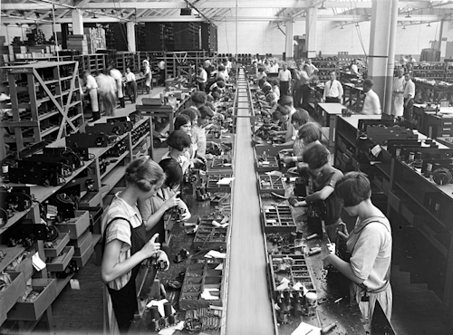
Fordist biz model
Mass production
Mass consumption
Vertical integration

Slide 18
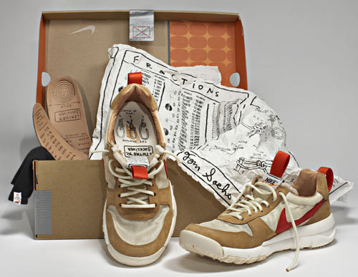
Post Fordist biz model
Flexible production
Individualized consumption, differentiating
Notes:
Nike

Slide 19
Platform economy
A platform is both an intermediary to make possible transactions between parts and an infrastructure in which one can build up services

Slide 20
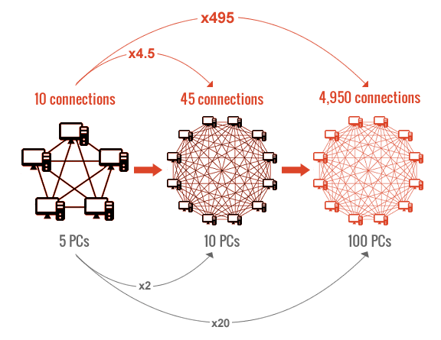
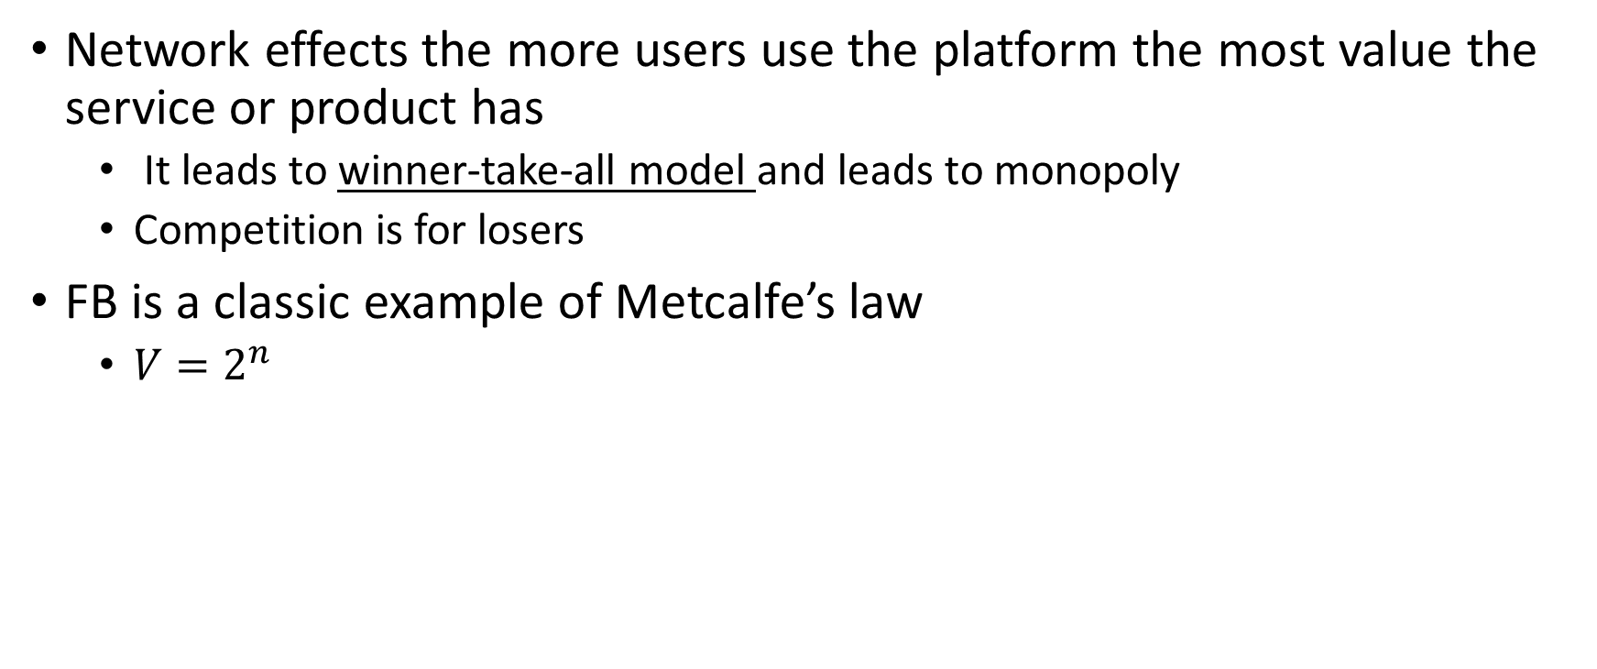
Network effects the more users use the platform the most value the service or product has
It leads to winner-take-all model and leads to monopoly
Competition is for losers
FB is a classic example of Metcalfe’s law
$V=2^{n}$
Notes:
Value grows exponentially with the number of users

Slide 21
Cross subsidization (amazon prime looses money but brings people into the system and more importantly make them captive)
Platform is not neutral it enforces and prevents behaviors and rules
For example, phantom cabs show more supply than real
Or rising price, manipulation of the market
Key advantage collect data

Slide 22
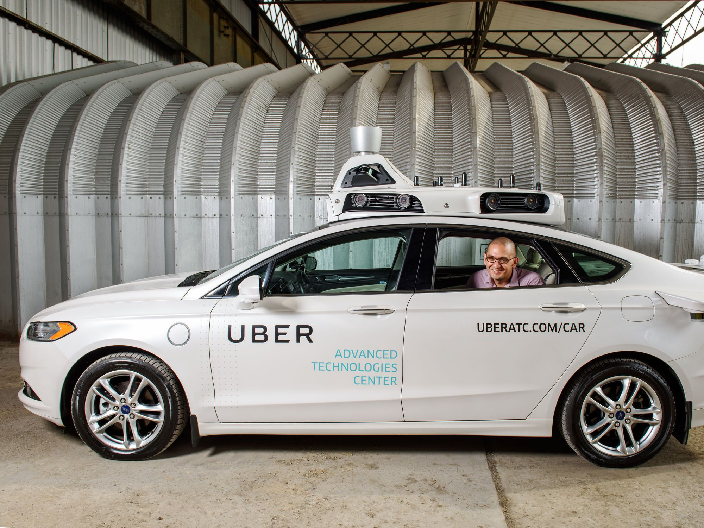
Types of platform
Advertising, google and FB , revenues come from ads
This means that they need to get more and better data from users, it follows from the premise, they will impinge upon privacy, no question
Cloud platform: AWS is the internet backbone, renting out infrastructure to other companies.
AWS, MSFT, GOOG build and rent cloud based ML
Notes:
(Uber even rents it
Overtime will have a monopoly position
s cmp power from AMZ)
bought CMI
It is often betterto own a platform thatbrings consumers together than owing the underlying asset

Slide 23

Uber AB&B: they own very little –asset-less.
Revenue doesn’t come from ad nor renting but from eliminating costs: “workers” pay for insurance, oil etc.
Self drive need so much data, will be unbeatable if they monopolize this kind of data car
Uber drivers are beta tester of the future driver-less uber, making themselves irrelevant in the long term

Slide 24
Macroeconomics
Notes:
How we got into here?

Slide 25
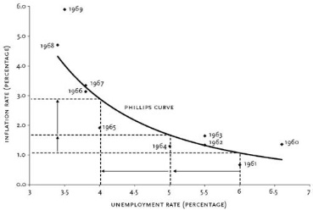
Philips curve: inverse relationship between the level of unemployment and the rate of inflation
Increased level of employment correlates with high inflation

Slide 26
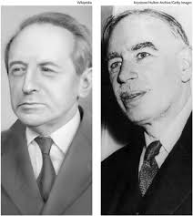
The Goodhart’s law:
Targeting any variable long enough undermines the value of the variable itself
Kalecki: once you target and sustain full employment over time (tight job market), it basically becomes costless for labor to move from job to job.
Wages will have to continually rise to hold onto labor, and the only way business can accommodate that is to push up prices. This pushes inflation because prices and wages push each other up.
In the 70s the end of Keynesianism with too much inflation (oil shock, end of the gold-dollar peg monetary system etc.) the system undermined itself
Notes:
How we got there?
Wages (employers to retain employees) in such a world

Slide 27
Tight job market, it is costless for labor to move from job to job. Wages will have to continually rise to hold onto labor, pushing up prices (Inflation)
Full employment
Inflation
Deflation
target—price stability , to restore the value of debt and discipline labor through unemployment
In a deflationary world, the debtors can’t pay the debt

Slide 28
The new order is called neoliberalism. Over the next thirty years the world was transformed from a debtor’s paradise into a creditor’s paradise where capital’s share of national income rose to an all-time high as labor’s share fell as wages stagnated (M. Blythe)
Notes:
Inflation acts as a tax on the returns on investment and lending. Unsurprisingly, in response, employers and creditors mobilized and funded a market-friendly revolution where the goal of full employment was jettisoned for a new target—price stability, aka inflation, to restore the value of debt and discipline labor through unemployment
Just as targeting full employment undermined itself, so did making inflation the policy target.

Slide 29
 | Target
post war Bretom Woods) 45-70 target | Unemployment
Post Nixon's shock (70-2008) | Inflation
2008- | To service your debt, austerity, no spending….
Before 2008, pro-trade economists called the Inflation target period and pro-trade activists called it “The Great Moderation.” (Bernanke) The world was going to be more global, richer, happier..
a reversal of power between creditors and debtors as the anti-inflationary regime of the past 30 years undermines itself, the middle class were the debtors, but now as debtors in a deflationary world are powerless.
Notes:
This was a huge corporate propaganda campaign
the world’s major central banks have dumped at least $12$ trillion dollars into the global economy and there is barely any inflation anywhere!

Slide 30
TINA

Slide 31
In a deflationary world, the debtors can’t pay the debt—and politically, and this is crucial— it empowers debtors since they can’t pay, won’t pay, and still have the right to vote

Slide 32
Plato was against democracy
Aristotle “democracy is the government of the poor (MAJORITY) and the free.
This is the sentiment today, racial conflict is that, what if the poor, who let us not forget have the votes, unite and attack my privileges and my social condition.
Scale: in Athens, scale allowed directed decision making
But the minority rules at least if one pays attention to the immense role of political donors ( Koch brothers)
Tax evasions laws designed with this in minds (veto)
Tax avoidance is a competition issue and from that, taxation is subject to the unanimity rule in the Council, which means Ireland will simply veto everything, and therefore nothing will happen.
Christians won because they were fanatically stubborn, romans, the majority could not resist the minority. (NA. Taleb. Antifragility)
Notes:
Mario Monti:

Slide 33
Secular stagnation

Slide 34
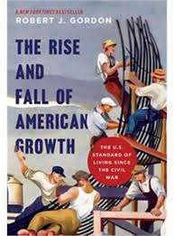
(Robert Gordon) supply side: a decline in the rate of productivity growth relative to the golden age 1870-1970
The more productive you get the smaller % of the GDP you capture, for example agriculture was 80% of the GDP now is marginal
Similarly for manufacturing
Knowledge economy: marketing, persuasion, attention economy
Software requires different set of skills than automobile factory, the educational system is failing to (re)educate and people are being penalized and left behind
This is a driven force in Inequality: HAVE vs HAVE NOTS
World Inequality have diminished quite dramatically but within countries is increasing

Slide 35
Whose recovery?
Job insecurity would tend to lower the likelihood of people moving jobs
(Greenspan 1997) “Surveys suggest around a quarter of workers currently are afraid of losing their jobs, the highest level in several decades”
Notes:
job-to-job flows began rising slowly after 2010 but remain at levels well below their pre-crisis levels

Slide 36
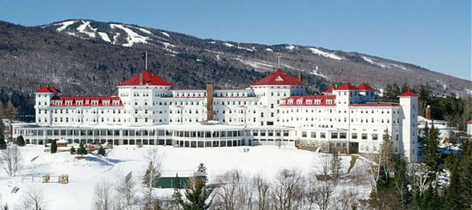
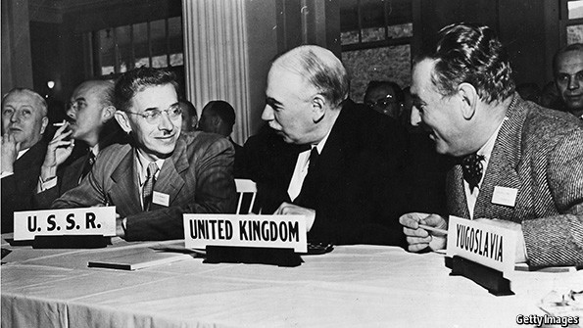
Finatialization rules

Slide 37
How finantialization happened?
Bretton Woods recycling of surpluses and deficits to keep stable interest rates
In 1945 Europe that need to be rebuilt, the US was the surpluser, its surplus was went to Europe to be rebuilt, this keep the economy, globally, growing and stable
When Europe was rich and rebuilt, they started exporting themselves, the US became and importer
EU and China, Japan became the surplusers of the world, the surplus built the social well fare in Europe via Wall Street
Notes:
Not through infra structure or other forms of deficit spending ,which but.
Finantialization happened sending surplus from the non US to the US via Wall Street.

Slide 38
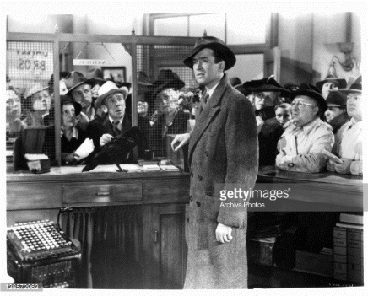
A bank tale: banks are places where people gather and bring money so that banks can lend it to someone else
Read almost any economics or finance textbook, and it will describe how banks take money from savers and lend it to business borrowers, allocating money among alternative capital investment projects
Notes:
Jimmy Stewart

Slide 39
But this is fictitious
banks do not intermediate already existing money, but create credit, money, and purchasing power which did not previously exist EX NOVO
not support new business investment but instead funds either increased consumption or the purchase of already existing assets, in particular real estate and the urban land on which it sits

Slide 40
What’s Money?
Medium of exchange and repayment of debt
Legal tender for Store of value
Unit of accounting
Fiat money is the way the rich stay rich, before there were many moneys but then the powerful force to use only their money and to have it you have to borrow and pay back at interest (Douglas Rushkoff)
Currency is about power not trade.

Slide 41
The fundamental problem is that modern financial systems are non self-regulating systems
Left to themselves inevitably create debt in excessive quantities
Notes:
Financial stability in modern economies, lies the intersection between the infinite capacity of banks to create new credit, money, and purchasing power, and the scarce supply of irreproducible urban land. (Adair Turner)

Slide 42
Bubbles can be explained as positive feedback loop mechanisms and as such are essentially unstable.
Biological and technical systems, on the other hand, operate using negative feedback to overlook stability and successful performance.
Financial markets and the agents within, have no interest in the permanence nor the stability of the system, they rather look after the discovery of arbitrage opportunities to be exploited rapidly enough before equilibrium is reached.
Notes:
Bubbles: Applied to the capital markets the term bubble is non-specific

Slide 43
Study bubbles not as harmful events that need to be anticipated and corrected by forecasters and regulators (with little success), but as self correcting mechanisms that could have beneficial effects
neurobiologists have shown that stressful events (not chronic stress) produces neurogenesis, (proliferation of new brain cells) in the hippocampus, and in the dorsal dentate gyrus

Slide 44
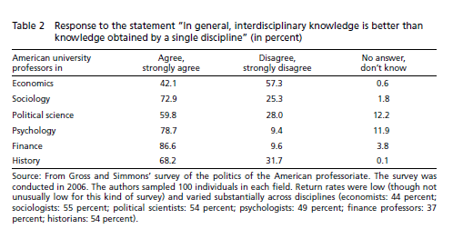
Economics is a mono culture
Of the interdisciplinary "tale" only economists seems shamelessly wrong and also truly honest in their responses
Notes:
Fourcade, Ollion and Algan (2015) Put nature article
However. while borrowing from biology and other natural science is not only extremely useful but sorely need in a discipline as strongly mathematized and insular as economics, financial systems have intrinsic properties that make them unsuitable for naive "naturalization" in biological basis.

Slide 45
The march of commodification
The march of commodification aka exchange vale, against experiential or use value, the inexorable march of the commodity that takes over all goods to commodify them
commodification is the force that drives capitalism.
Ideally, capitalism would like to take labour out of labourers to do not have to deal with them (perfect commodification) the iron law of capitalism is commodification
Through technology, labour can be effectively taken from labourers

Slide 46
Goods are commodities, they are exchanged.
Money is a good and a commodity, it has a price and can be traded.
The price of money is the interest rate
But money is not as other commodities
If I got potatoes and nobody want them, if I want to clear up my stock just reduce the price
But money price is psychological, the more I cheapen the price the more the other think it is preferable to keep it
Money is a second order commodity, that is, the decision of save or invest is always about future flow cash

Slide 47
Savers and investor are the same thing, they are both lenders, the Saver lends to herself and the investor to someone else.
Economic or financial decision making what really matters is the other's people mind problem
That is why economics is SO HARD
Planck confessed to Keynes that in his early life had thought of studying economics, but had found it too difficult!

Slide 48
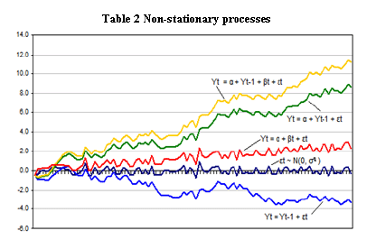

Slide 49
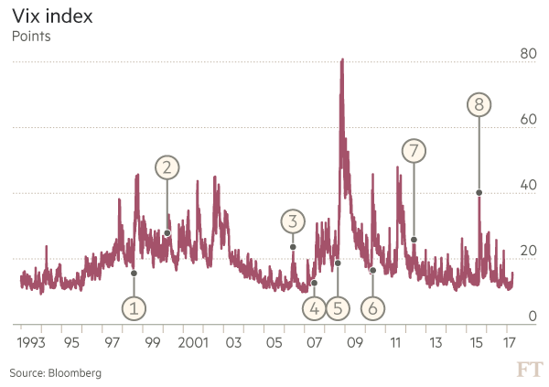
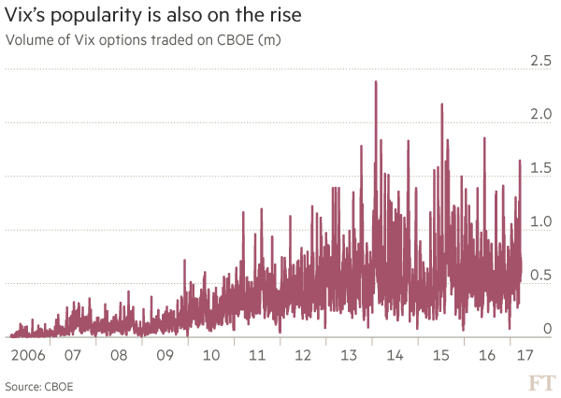
VIX Index

Slide 50
Coda: Is technology killing capitalism?

Slide 51
Capitalism had socialism as its intellectual rival or dancing partner. The conditions have changed, not through ideology but through technology
The IT will do what the left has failed to do, OVERTHROW capitalism
Software is EATING the WORLD (Marc Andreesen)

Slide 52
Software spends far more of its time in a LOOP.
Crafts professions are based on the loop, the repetitive pattern to the pursue of expertise (coders, pilots, surgeons) so do work (loop) to acquire some expertise and feed our families.
Software is threatening not only low value repetitions but also high value REPETITION BEHAVIOR.
A radiologist who has been trained for many years in order to make tricky diagnosis potentially will be obviated by a "deep learning“

Slide 53
Professions that were not a zero sum game (you might not need to be the best doctor, just someone that knows ho to fix a leg) are indeed now following the same non-consensus approach, with purely survival gains.
The only place where humans have some edge over machines, creativity spark, singular act, creation.
Notes:
All of the consensus already baked into the price, in order to make money in the market you need to see something that the consensus does not see, so you need to have an independent point of view.
Double Irish With A Dutch Sandwich : send profit to an irish subsidiary, then to a dutch and then back to a second ireland company headquarter in a tax heaven. Mario Monti: was the first one to really suggest that tax avoidance is a competition issue (He should know, coming from Italy). And from that, taxation is subject to the unanimity rule in the Council, which means Ireland will simply veto everything, and therefore nothing will happen.

Slide 54
Alternatives for a better future
Change the OS of the economy from going from an extractive to a distributive model
Amazon owned by its sellers, Uber owned by its drivers, and Facebook is owned by the people who create its content
Reject platform monopolies like Uber in favor of distributed, worker-owned co-ops, orchestrated through collective authentication systems like blockchain ing digital distributed payment system (crypto currencies)
crypto currency endogenous algorithms built in so when recession hits the increment the money supply and to contract later on without having political agendas of people at the helm

Slide 56
